Slide 1



Department of computer AND ENGINEERING NATIONAL INSTITUTE OF TECHNOLOCY WARANGAL
PROJECT WORK
ON
DATABASE MANAGEMENT SYSTEM
PREPARED BY:-
AARYAN MADAL 21CSB0A01
TEJAS MAKODE 21CSB0A34

Slide 2


project TITLE BYCLE SALE AND RENTAL DATABASE MANAGEMENT SYSTEM

Slide 3
INDEX:
PAGE NO
4. | INTODUCTION
5. | TABLES
6. | ENTITY RELATIONSHIP MODEL
7-8 | RELATION SCHEMA
9. | RELATIONS
10-16 | NORMALISATION
17-20 | CREATION OF TABLES
21-26 | INSERTION QUERIES
27. | TRIGGER(PL-SQL)

Slide 4
INTRODUCTION:
Welcome to our Sale or Rental Bicycle Management System database management system (DBMS) project for students of NITW. The design and implementation of a DBMS that can effectively handle bicycle sales and rentals is the aim of this project.
There is a rising need for dependable and effective bicycle management systems as cycling as a mode of transportation gains popularity. By developing a system that can track inventory, rental history, client data, and sales data, our project attempts to fill this demand.
The DBMS will include a database that includes all pertinent data pertaining to the management of bicycles. The database will have a user-friendly interface and be available to authorised staff

Slide 5
TABLES:
CYCLES- It has information about the cycles like CYCLE_ID, PURCHASE_ID, their prices, etc.
CYCLE_SPECS - It has info about the specifications of the cycle like does it has gear or not ,etc.
MANUFACTURER- It has info about the manufacturer of the cycle like the contact info, MANUFACTURE_ID, etc.
SALE_TABLE- It contains info about the cycles sold
RENT_TABLE- It contains info about the cycles rented
STUDENTS- It contains info about the students like STUD_ID, NAME etc.
PAYMENTS- It contains info about all the payments made in the database.

Slide 6
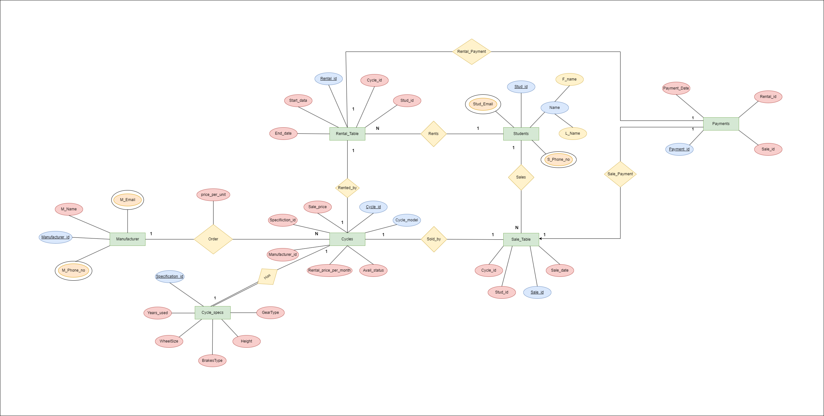
ENTITY RELATIONSHIP MODEL:

Slide 7
RELATIONAL SCHEMA :
CYCLES:(CYCLE_ID(PK),SPECIFICATION_ID(FK), MANUFACTURER_ID(FK), RENTAL_PRICE_PER_MONTH,
AVAIL_STATUS, CYCLE_TYPE,SALE_PRICE)
CYCLE_SPECS:(SPECIFICATION_ID(PK),YEARS_USED,GEAR_TYPE,HEIGHT,BRAKESTYPES,WHEELSIZE)
MANUFACTURER:(MANUFACTURER_ID(PK), M_NAME,M_EMAIL,M_PHONE_NO)
RENTAL_TABLE:(RENTAL_ID(PK),CYCLE_ID(FK),STUD_ID(FK),END_DATE,START_DATE,RENTAL_COST)
SALE_TABLE:(SALE_ID(PK),STUD_ID(FK),CYCLE_ID(FK),SALE_DATE,SALE_PRICE)
STUDENT:(STUD_ID(PK),F_NAME,L_NAME,STUD_EMAIL,S_PHONE_NO)
PAYMENTS:(PAYMENT_ID(PK), SALE_ID(FK), RENTAL_ID(FK),PAYMENT_DATE)

Slide 8
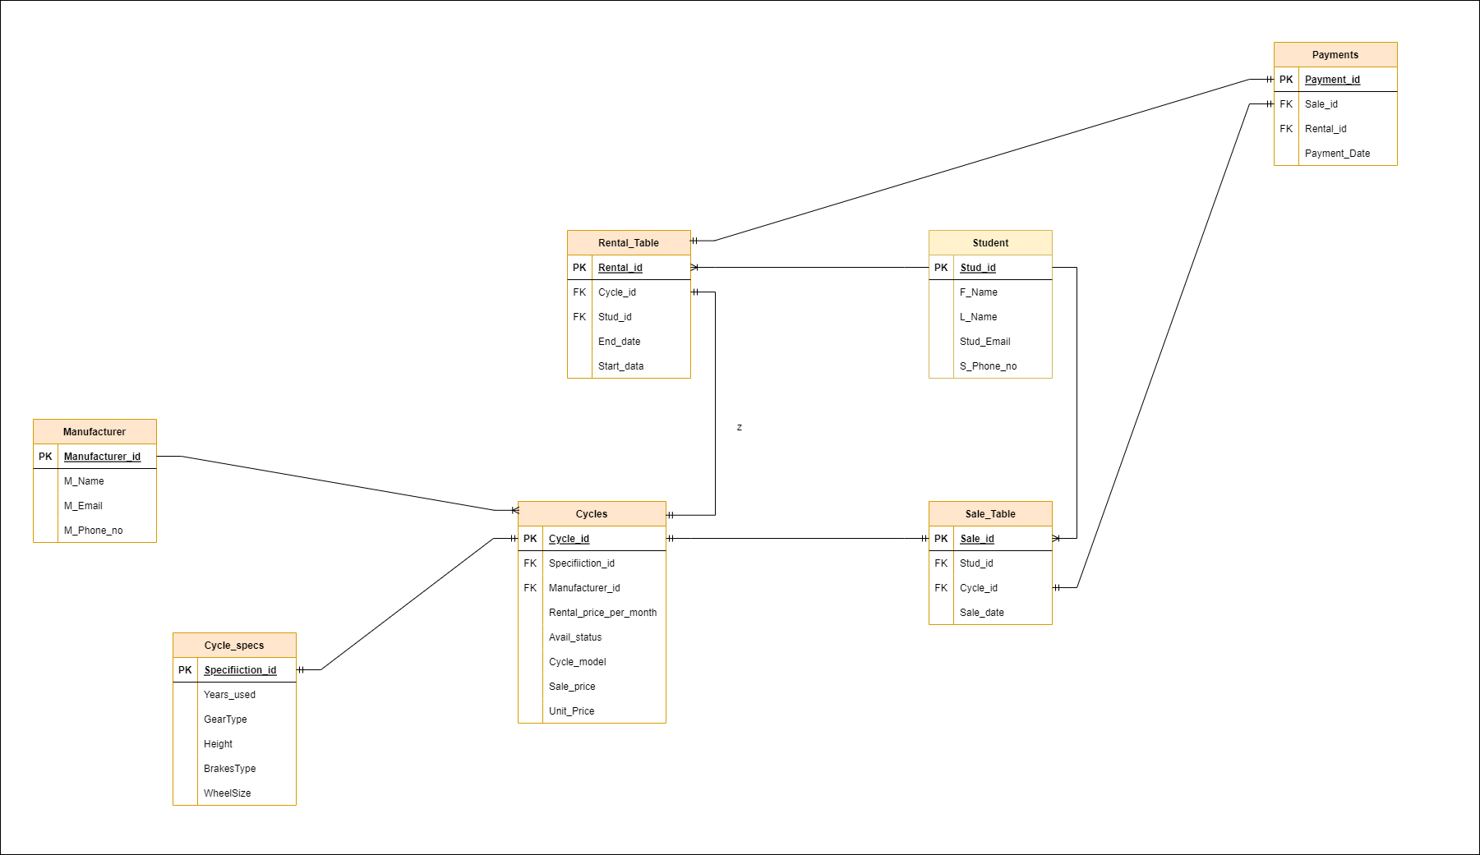

Slide 9
RELATIONS:
ONE- ONE:
CYCLES TO CYCLE_SPECS
RENTAL_TABLE TO CYCLES
SALE_TABLE TO CYCLES
RENTAL_TABLE TO PAYMENTS
SALE_TABLE TO PAYMENT
ONE-MANY:
STUDENT TO SALE_TABLE
STUDENT TO RENTAL_TABLE
MANUFACTURER TO CYCLES

Slide 10
NORMALIZATION:-
What is Normalization ?
Normalization is the process of organizing the data in the database.
Normalization is used to minimize the redundancy from a relation or set of relations.
It is also used to eliminate undesirable characteristics like Insertion, Update, and
Deletion Anomalies.
Normalization divides the larger table into smaller and links them using relationships.
The normal form is used to reduce redundancy from the database table.

Slide 11
Normalization in this project:-
CYCLE TABLE:
CYCLES(CYCLE_ID,SPECIFICATION_ID,MANUFACTURER_ID,RENTAL_PRICE_PER_MONTH,AVAIL_STATUS,CYCLE_MODEL,SALE_PRICE,UNIT_PRICE)
CYCLE_ID-> SPECIFICATION_ID,
CYCLE_ID->MANUFACTURER_ID,
CYCLE_ID->RENTAL_PRICE_PER_MONTH,
CYCLE_ID->AVAIL_STATUS,
CYCLE_ID->CYCLE_MODEL,
CYCLE_ID->SALE_PRICE,
CYCLE_ID->UNIT_PRICE
No Partial Dependencies exists. Hence it is also in 2NF
No Transitive Dependencies exists. Hence it is also in 3NF.
The given table is in BCNF form.

Slide 12
STUDENT TABLE:
STUDENT(STUD_ID,F_NAME,L_NAME,STUD_EMAIL,S_PHONE_NO)
STUD_ID-> F_NAME,
STUD_ID->L_NAME,
STUD_ID->STUD_EMAIL,
STUD_ID->S_PHONE_NO
No Partial Dependencies exists. Hence it is also in 2NF
No Transitive Dependencies exists. Hence it is also in 3NF.
The given table is in BCNF form.

Slide 13
RENTAL TABLE:
RENTAL_TABLE(RENTAL_ID,CYCLE_ID,STUD_ID,END_DATE,START_DATE)
RENTAL_ID-> CYCLE_ID,
RENTAL_ID->STUD_ID,
RENTAL_ID->END_DATE,
RENTAL_ID->START_DATE
No Partial Dependencies exists. Hence it is also in 2NF
No Transitive Dependencies exists. Hence it is also in 3NF.
The given table is in BCNF form.

Slide 14
SALE TABLE:
SALE_TABLE(SALE_ID,STUD_ID,CYCLE_ID,SALE_DATE)
SALE_ID-> STUD_ID,
SALE_ID->CYCLE_ID,
SALE_ID->SALE_DATE
No Partial Dependencies exists. Hence it is also in 2NF
No Transitive Dependencies exists. Hence it is also in 3NF.
The given table is in BCNF form.
MANUFACTURER TABLE:
MANUFACTURER(MANUFACTURER_ID,M_NAME,M_EMAIL,M_PHONE_NO)
MANUFACTURER_ID-> M_NAME,
MANUFACTURER_ID->M_EMAIL,
MANUFACTURER_ID->M_PHONE_NO

Slide 15
No Partial Dependencies exists. Hence it is also in 2NF
No Transitive Dependencies exists. Hence it is also in 3NF.
The given table is in BCNF form.
CYCLE_SPECS TABLE:
CYCLE_SPECS(SPECIFICATION_ID,YEARS_USED,GEARTYPE,HEIGHT,BRAKESTYPE,WHEELSIZE)
SPECIFICATION_ID-> YEARS_USED,
SPECIFICATION_ID->GEARTYPE,
SPECIFICATION_ID->HEIGHT,
SPECIFICATION_ID->BRAKESTYPE,
SPECIFICATION_ID->WHEELSIZE
No Partial Dependencies exists. Hence it is also in 2NF
No Transitive Dependencies exists. Hence it is also in 3NF.
The given table is in BCNF form.

Slide 16
PAYMENTS TABLE:
PAYMENTS(PAYMENT_ID,SALE_ID,RENTAL_ID,PAYMENT_DATE)
PAYMENT_ID-> SALE_ID,
PAYMENT_ID->RENTAL_ID,
PAYMENT_ID->PAYMENT_DATE
No Partial Dependencies exists. Hence it is also in 2NF
No Transitive Dependencies exists. Hence it is also in 3NF.
The given table is in BCNF form.

Slide 17
CREATION AND INSERTION OF TABLES MENTIONED ABOVE:
STUDENT TABLE –
CREATE TABLE STUDENT(
STUD_ID VARCHAR(30) NOT NULL PRIMARY KEY,
FNAME VARCHAR(30),
LNAME VARCHAR(30),
STUD_EMAIL VARCHAR(30),
S_PHONE_NO VARCHAR(20)
);
DESC STUDENT;
MANUFACTURER TABLE –
CREATE TABLE MANUFACTURER(
MANUFACTURER_ID VARCHAR(30),
M_NAME VARCHAR(30),
M_EMAIL VARCHAR(30),
M_PHONE_NO VARCHAR(10),
PRIMARY KEY(MANUFACTURER_ID)
);
DESC MANUFACTURER;

Slide 18
CYCLE_SPECS TABLE –
CREATE TABLE CYCLE_SPECS(
SPECIFICATION_ID VARCHAR(30)NOT NULL PRIMARY KEY,
YEARS_USED INT,
GEARTYPE VARCHAR(30),
HEIGHT NUMBER,
BRAKESTYPE VARCHAR(30),
WHEELSIZE NUMBER
);
DESC CYCLE_SPECS;
CYCLE TABLE –
CREATE TABLE CYCLES(
CYCLE_ID VARCHAR(30) ,
SPECIFICATION_ID VARCHAR(30),
MANUFACTURER_ID VARCHAR(30),
CYCLE_MODEL VARCHAR(30),
PRICE_PER_UNIT NUMBER,
RENTAL_PRICE_PER_MONTH INT,
AVAIL_STATUS VARCHAR(2),
SALE_PRICE NUMBER,
PRIMARY KEY(CYCLE_ID),
FOREIGN KEY (SPECIFICATION_ID) REFERENCES CYCLE_SPECS(SPECIFICATION_ID),
FOREIGN KEY (MANUFACTURER_ID) REFERENCES MANUFACTURER(MANUFACTURER_ID)
);
DESC CYCLES;

Slide 19
SALES TABLE –
CREATE TABLE SALE_TABLE(
SALE_ID VARCHAR(30) PRIMARY KEY,
STUD_ID VARCHAR(30),
CYCLE_ID VARCHAR(30),
FOREIGN KEY (CYCLE_ID) REFERENCES CYCLES(CYCLE_ID),
FOREIGN KEY (STUD_ID) REFERENCES STUDENT(STUD_ID)
);
DESC SALE_TABLE;
RENTAL TABLE –
CREATE TABLE RENTAL_TABLE(
RENTAL_ID VARCHAR(30) PRIMARY KEY,
CYCLE_ID VARCHAR(30),
STUD_ID VARCHAR(30),
START_DATE DATE,
END_DATE DATE,
FOREIGN KEY (CYCLE_ID) REFERENCES CYCLES(CYCLE_ID),
FOREIGN KEY (STUD_ID) REFERENCES STUDENT(STUD_ID)
);
DESC RENTAL_TABLE;

Slide 20
PAYMENT TABLE –
CREATE TABLE PAYMENTS(
PAYMENT_ID VARCHAR(30) PRIMARY KEY,
SALE_ID VARCHAR(30),
RENTAL_ID VARCHAR(30),
PAYMENT_DATE TIMESTAMP,
FOREIGN KEY (SALE_ID) REFERENCES SALE_TABLE(SALE_ID),
FOREIGN KEY (RENTAL_ID) REFERENCES RENTAL_TABLE(RENTAL_ID)
);
DESC PAYMENTS;

Slide 21
INSERT QUERIES:
STUDENT TABLE:
INSERT INTO STUDENT VALUES('ST01','AMAN','RANA','RANA@GMAIL.COM',8334567891);
INSERT INTO STUDENT VALUES('ST02','DHRUV','PATEL','PATEL@GMAIL.COM',8334567823);
INSERT INTO STUDENT VALUES('ST03','AARYAN','MADAL','MADAL@GMAIL.COM',9234563491);
INSERT INTO STUDENT VALUES('ST04','GOKANI','BHAI','BHAI@GMAIL.COM',7542345678);
INSERT INTO STUDENT VALUES('ST05','DHYEY','YEY','YEY@GMAIL.COM',1234532781);
INSERT INTO STUDENT VALUES('ST06','TEJAS','MAKODE','MAKODE@GMAIL.COM',8964527891);
INSERT INTO STUDENT VALUES('ST07','BHOLU','RAI','RAI@GMAIL.COM',9434467891);
INSERT INTO STUDENT VALUES('ST08','AMIT','KUMAR','KUMAR@GMAIL.COM',8765345891);
INSERT INTO STUDENT VALUES('ST09','RAHUL','KUMAR','RAHUL@GMAIL.COM',9934563891);
INSERT INTO STUDENT VALUES('ST10','JATIN','SANGA','SANGA@GMAIL.COM',7734564691);
SELECT * FROM STUDENT;

Slide 22
MANUFACTURER TABLE:
INSERT INTO MANUFACTURER VALUES('MT01','A-COMPANY','A@GMAIL.COM',9426781919);
INSERT INTO MANUFACTURER VALUES('MT02','B-COMPANY','B@GMAIL.COM',9834534919);
INSERT INTO MANUFACTURER VALUES('MT03','C-COMPANY','C@GMAIL.COM',4334535419);
INSERT INTO MANUFACTURER VALUES('MT04','D-COMPANY','D@GMAIL.COM',6436343519);
INSERT INTO MANUFACTURER VALUES('MT05','E-COMPANY','E@GMAIL.COM',4326453219);
SELECT * FROM MANUFACTURER;

Slide 23
CYCLE_SPECS TABLE:
INSERT INTO CYCLE_SPECS VALUES('SP01',1,'GR',26,'DISC',10);
INSERT INTO CYCLE_SPECS VALUES('SP02',0,'NGR',20,'NDISC',12);
INSERT INTO CYCLE_SPECS VALUES('SP03',1,'NGR',20,'NDISC',14);
INSERT INTO CYCLE_SPECS VALUES('SP05',0,'GR',18,'NDISC',13);
INSERT INTO CYCLE_SPECS VALUES('SP06',0,'GR',22,'NDISC',11);
INSERT INTO CYCLE_SPECS VALUES('SP07',2,'NGR',24,'NDISC',14);
INSERT INTO CYCLE_SPECS VALUES('SP08',0,'GR',20,'DISC',12);
INSERT INTO CYCLE_SPECS VALUES('SP09',0,'NGR',20,'DISC',10);
SELECT * FROM CYCLE_SPECS;

Slide 24
CYCLES TABLE:
INSERT INTO CYCLES VALUES('CY01','SP01','MT01','M1',6000,300,'Y',8000);
INSERT INTO CYCLES VALUES('CY02','SP02','MT02','M2',6500,200,'Y',7000);
INSERT INTO CYCLES VALUES('CY03','SP01','MT03','M2',5500,100,'Y',6000);
INSERT INTO CYCLES VALUES('CY04','SP03','MT01','M2',5000,200,'Y',5000);
INSERT INTO CYCLES VALUES('CY05','SP02','MT04','M1',4000,300,'Y',5500);
INSERT INTO CYCLES VALUES('CY06','SP05','MT03','M1',6000,100,'Y',6500);
INSERT INTO CYCLES VALUES('CY07','SP05','MT01','M1',7500,100,'Y',9000);
INSERT INTO CYCLES VALUES('CY08','SP03','MT02','M3',6000,150,'Y',7000);
INSERT INTO CYCLES VALUES('CY09','SP02','MT02','M3',6000,100,'Y',7000);
INSERT INTO CYCLES VALUES('CY010','SP01','MT01','M3',7000,100,'Y',8000);
SELECT * FROM CYCLES;

Slide 25
RENTAL TABLE:
INSERT INTO RENTAL_TABLE VALUES('RT01','CY01','ST01',TO_DATE('12-2-2022','DD-MM-YYYY'),TO_DATE('12-2-2023','DD-MM-YYYY'));
INSERT INTO RENTAL_TABLE VALUES('RT02','CY02','ST03',TO_DATE('10-3-2022','DD-MM-YYYY'),TO_DATE('10-12-2022','DD-MM-YYYY'));
INSERT INTO RENTAL_TABLE VALUES('RT03','CY03','ST02',TO_DATE('09-2-2022','DD-MM-YYYY'),TO_DATE('09-4-2022','DD-MM-YYYY'));
INSERT INTO RENTAL_TABLE VALUES('RT04','CY04','ST05',TO_DATE('22-2-2022','DD-MM-YYYY'),TO_DATE('22-6-2022','DD-MM-YYYY'));
INSERT INTO RENTAL_TABLE VALUES('RT05','CY05','ST06',TO_DATE('12-6-2022','DD-MM-YYYY'),TO_DATE('12-6-2023','DD-MM-YYYY'));
SELECT * FROM RENTAL_TABLE;

Slide 26
SALE TABLE:
INSERT INTO SALE_TABLE VALUES('SA01','ST06','CY06');
INSERT INTO SALE_TABLE VALUES('SA02','ST06','CY07');
INSERT INTO SALE_TABLE VALUES('SA03','ST06','CY08');
INSERT INTO SALE_TABLE VALUES('SA04','ST06','CY09’);
SELECT * FROM SALE_TABLE;
PAYMENT TABLE:
INSERT INTO PAYMENTS VALUES('PY01','SA01',NULL,'11-APR-2023 11:45:11 AM');
INSERT INTO PAYMENTS VALUES('PY02','SA02',NULL,'12-JUN-2023 09:02:11 PM');
INSERT INTO PAYMENTS VALUES('PY03',NULL,'RT01','12-FEB-2022 03:10:11 PM');
INSERT INTO PAYMENTS VALUES('PY04',NULL,'RT02','10-MAR-2022 09:45:11 PM');
INSERT INTO PAYMENTS VALUES('PY05',NULL,'RT03','09-FEB-2022 02:33:11 PM');
INSERT INTO PAYMENTS VALUES('PY06',NULL,'RT04','22-FEB-2022 08:23:11 AM');
INSERT INTO PAYMENTS VALUES('PY07',NULL,'RT05','12-JUN-2022 10:02:11 PM');
INSERT INTO PAYMENTS VALUES('PY08','SA03',NULL,'09-AUG-2022 6:45:11 PM');
INSERT INTO PAYMENTS VALUES('PY09','SA04',NULL,'11-JAN-2023 7:55:11 PM');
SELECT * FROM PAYMENTS;

Slide 27
TRIGGER:
CREATE OR REPLACE TRIGGER PAID BEFORE INSERT OR UPDATE OR DELETE ON SALE_TABLE FOR
EACH ROW
BEGIN
UPDATE CYCLES
SET AVAIL_STATUS='N' WHERE CYCLE_ID=:NEW.CYCLE_ID;
END;
CREATE OR REPLACE TRIGGER RENT BEFORE INSERT OR UPDATE OR DELETE ON RENTAL_TABLE FOR
EACH ROW
BEGIN
UPDATE CYCLES
SET AVAIL_STATUS='N' WHERE CYCLE_ID=:NEW.CYCLE_ID;
END;

Slide 28
THANK YOU

